Slide 1
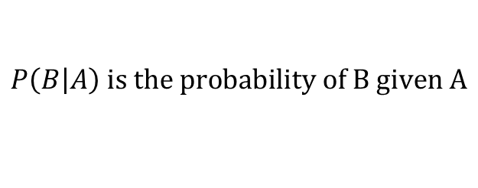

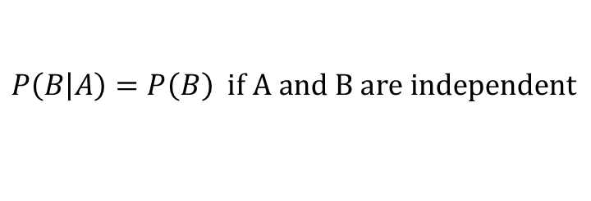

Joint and Conditional Probability
Compound Probability – the probability of all events occurring.
If all events are independent of one another then the compound probability equals the product of each event’s individual probability.
$$P\left(A∩B\right)=P(A)×P(B)$$
This equation can be used to test independence
Events are dependent if one or more events influence other events. Sampling without replacement is an example of dependent events.
Conditional Probability
Joint and Marginal Probability
$$P\left(B\left|A\right.\right) is the probability of B given A$$
Joint – probability of the intersection of multiple events.
Marginal – probability of a single event.
$$P\left(B\left|A\right.\right)=\frac{P(B∩A)}{P(A)}$$
$$P\left(B\left|A\right.\right)=P\left(B\right) if A and B are independent$$
Joint Probabilities
Marginal Probabilities

Slide 2



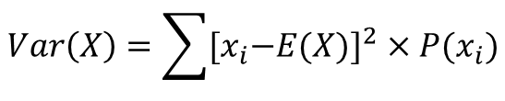
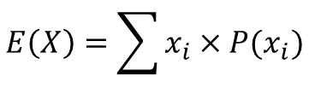

Bayes Rule & Random Variables
n! is n factorial
0! = 1
How can we pick k items from n choices where order matters?
Permutation is the number of ways we can arrange outcomes where order matters.
$$nPk=\frac{n!}{\left(n−k\right)!}$$
Combination is the number of ways we can arrange outcomes where order does not matters.
$$nCr=\left(\begin{matrix}n \\ r\end{matrix}\right)=\frac{n!}{r!\left(n−r\right)!}=\frac{nPr}{r!}$$
Bayes’ Theorem
$$P\left(B\left|A\right.\right)=\frac{P\left(A\left|B\right.\right)×P(B)}{P(A)}$$
Random Variable – an unknown variable encompasses all possible values in a sample space. It is designated by a capital letter. Specific values are denoted by a lowercase letter. They can be either discrete or continuous.
Discrete | Continuous
Can only take on specific values and therefore are countable | Can take on an infinite number of values in a range
Distinct between values in important | Distinction between values in not important
Assign probabilities to each discrete value | Assign probabilities to a range of values
If X is our random variable then what is the expected value of X? In other words what is E(X)?
$$E\left(X\right)=\sum{x_{i}×P(x_{i})}$$
$$Var\left(X\right)=\sum{{{[x}_{i}−E(X)]}^{2}×P(x_{i})}$$
$$σ\left(X\right)=\sqrt{Var(X)}$$

Slide 3
For what predictions from marketing research should we launch a new product?
These are marginal probabilities
This is a conditional probability matrix
P(Prediction X | Performance Y)
The expected value of a product = (0.20 * 2500 + 0.40 * 100 – 0.40 * 1500) = -60
This is the naïve expectation – in other words, the expected value if we launched every product developed.
So the question is, can we improve the expected value of launched products if the decision to launch is based on the prediction given by marketing research?
What we need to find is the conditional probability P(Performance X | Prediction Y)
We can use Bayes’ Theorem here because we have the flip side of the conditional probability available.
$$P\left(Performance X \right|Prediction Y)=\frac{P\left(Prediction Y | Performance X\right)∗P(Performance X)}{P(Prediciton Y)}$$
We have everything on the right side except for P(Prediction Y), so let’s compute this next…
Proof that these marginal probabilities can be computed as follows…
$$P\left(Pred Good | Perf Good\right)∗P\left(Perf Good\right) + P\left(Pred Good | Perf Average\right)∗P\left(Perf Average\right) + P\left(Pred Good | Perf Bad\right)∗P\left(Perf Bad\right)=$$
$$P\left(Pred Good ∩Perf Good\right) + P\left(Pred Good ∩Perf Average\right)+P\left(Pred Good ∩Perf Bad\right)=$$
$$P\left(Pred Good) ∗[P(Perf Good\right) + P(Perf Average)+P(Perf Bad)]=P(Pred Good)$$
We are in a position to assess whether the predictions from marketing research improves the expected value of product launch if we use their predictions as opposed to naively launching products…
We see from the revised expectations matrix that if we launch those products for which marketing research has predicted Good, then our expected value has improved from a loss of $60 to a gain of $346. If marketing research predicts Average or Bad, the expected value of launch remain negative and therefore we should decide to not launch those products.

Slide 4

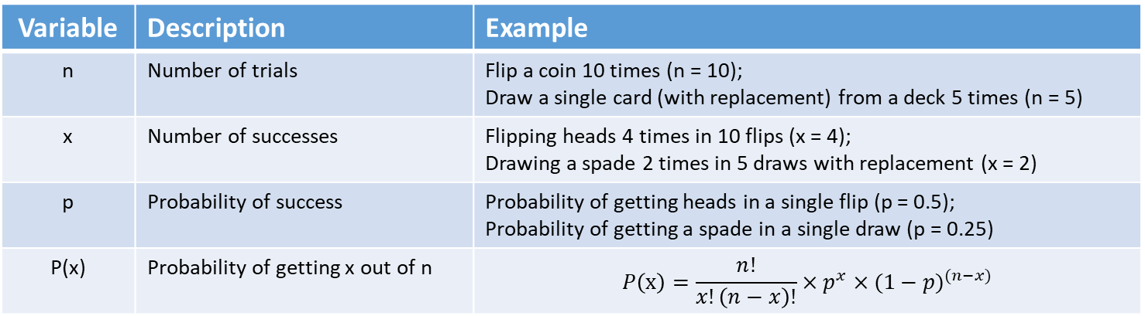

Binomial Distribution
A single trial has two possible outcomes – usually categorized as either a success or a failure. A failure is really the complement of a success, that is not a success. For example:
A coin flip → consider getting a heads as a success (note that this is arbitrary), then getting “tails” would be considered a failure, or better stated not getting heads.
Drawing a card from a deck → if you consider drawing a spade as a success (again this is arbitrary), then drawing a non-spade is a failure, or better stated not drawing a spade.
Variables in a Binomial Distribution
Variable | Description | Example
n | Number of trials | Flip a coin 10 times (n = 10); Draw a single card (with replacement) from a deck 5 times (n = 5)
x | Number of successes | Flipping heads 4 times in 10 flips (x = 4); Drawing a spade 2 times in 5 draws with replacement (x = 2)
p | Probability of success | Probability of getting heads in a single flip (p = 0.5); Probability of getting a spade in a single draw (p = 0.25)
P(x) | Probability of getting x out of n | $$P\left(x\right)=\frac{n!}{x!\left(n−x\right)!}×p^{x}×{(1−p)}^{(n−x)}$$
$$E\left(x\right)=np$$
BINOM.DIST
(Excel Function)
also see
BINOM.DIST.RANGE
$$Var\left(x\right)=np(1−p)$$

Slide 5
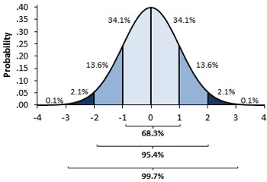



Functions of Random Variable
X is our random variable with the following mean and standard deviation
$$E\left(X\right)=μ_{X}$$
$$σ\left(X\right)=σ_{X}$$
If Y is a linear function of X, that is Y = f(X) = mX + b then
$$E\left(Y\right)=μ_{Y}=E\left(f\left(X\right)\right)=mE\left(X\right)+b=mμ_{X}+b$$
$$σ\left(Y\right)=σ_{Y}=σ\left(f\left(X\right)\right)=\left|m\right|σ\left(X\right)=\left|m\right|σ_{X}$$
Normal Distribution
Z-Score is the number of standard deviations a value is from the mean
$$z=\frac{x−μ}{σ}$$
NORM.S.DIST Excel function that calculates the left-sided cumulative probability based on the standard normal distribution using the z-score directly.
NORM.DIST Excel function that calculates the left-sided cumulative probability based on the standard normal distribution using the value, mean and standard deviation.
NORM.INV Excel function that calculates x value that results in the z-score that yields the desired left-sided cumulative probability. This is the inverse of NORM.DIST
NORM.S.INV Excel function that calculates z-score that results in the desired left-sided cumulative probability. This is the inverse of NORM.S.DIST

Slide 6



Confidence Intervals
Key Concepts: normal distribution, z-score
A confidence interval as two key properties – 1) a level of confidence expressed as a percentage and 2) a range between and lower value and upper value. The alpha is the percentage level representing a range of values outside the confidence interval and equals 100% - % confidence. Note that $\frac{alpha}{2}$ is the one-tailed z-score.
Joint Random Variables
Joint random variables represent the probability of the intersection of each of the random variable assuming some specific value. For example: X is the event of rolling a six-sided dice and Y is the event of flipping a fair coin.
If X and Y are independent: then P(X = x and Y = y) = P(X = x) * P(Y = y)
If X and Y are NOT independent: then P(X = x and Y = y) ≠ P(X = x) * P(Y = y)
In this case we have to consider the covariance / correlation between X and Y.
$$E\left(XY\right)−μ_{X}μ_{Y}$$
$$r=\frac{cov(X,Y)}{σ_{X}σ_{Y}}$$
$$\frac{\sum_{i=1}^{n}{(x_{i}−\overline{x})(y_{i}−\overline{y})}}{n−1}$$

Slide 7






Portfolio Analysis
$$E\left(X+Y\right)=μ_{X}+μ_{Y}$$
$$E\left(X−Y\right)=μ_{X}−μ_{Y}$$
$$E\left(aX+bY\right)={aμ}_{X}+bμ_{Y}$$
$Var\left(X+Y\right)=σ_{X}^{2}$ + $σ_{Y}^{2}+2Cov(X, Y)$
$Var\left(X−Y\right)=σ_{X}^{2}$ + $σ_{Y}^{2}−2Cov(X, Y)$
$Var\left(aX+bY\right)={a^{2}σ}_{X}^{2}$ + $b^{2}σ_{Y}^{2}+2abCov\left(X, Y\right)={a^{2}σ}_{X}^{2}\text{ + }b^{2}σ_{Y}^{2}+2abCorr\left(X, Y\right)σ_{X}σ_{Y}$
If X and Y are independent
$Var\left(aX+bY\right)={a^{2}σ}_{X}^{2}$ + $b^{2}σ_{Y}^{2}$

Slide 8
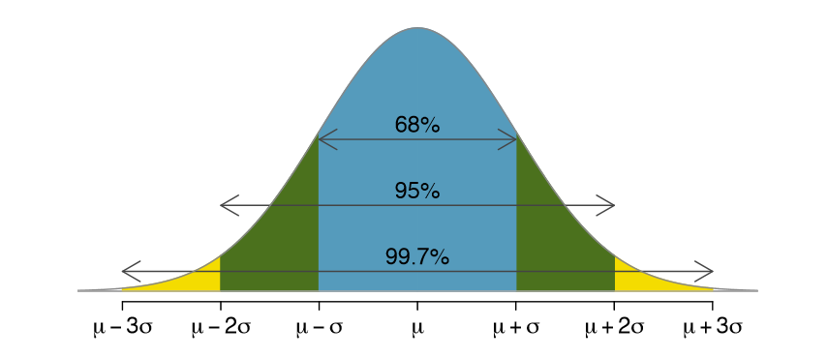
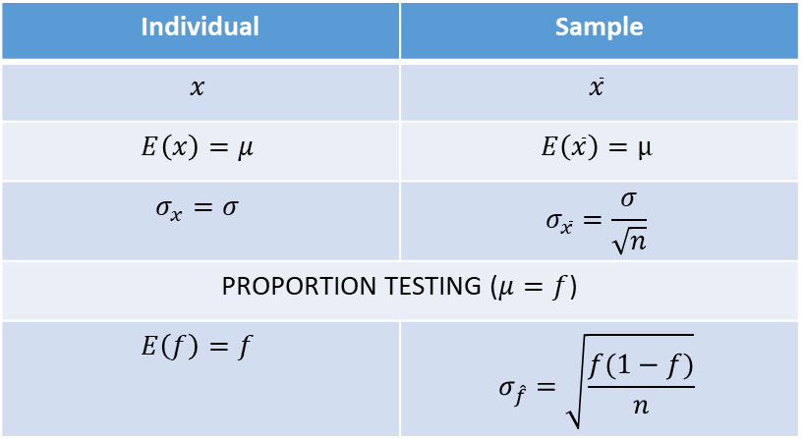
Sampling
Population: is a large group that we want to know some properties about but its size makes it impossible to exhaustively calculate the value of these properties.
Sample: is a representative subset of the population that can be used to estimate the properties of the population. The larger the sample the better the property estimates of the population. The key population properties are the population mean and population standard deviation.
Central Limit Theorem: if you take samples from a population, then the probability distribution of the samples’ means is going to be normally distributed with a mean equaling the population mean. This holds regardless of the shape of the population’s distribution.
This is called the sampling distribution
The standard deviation of the sampling distribution is a function the sample size (n).
Individual | Sample
$$x$$ | $$\overline{x}$$
$$E\left(x\right)=μ$$ | $$E\left(\overline{x}\right)=μ$$
$$σ_{x}=σ$$ | $$σ_{\overline{x}}=\frac{σ}{\sqrt{n}}$$
PROPORTION TESTING ($μ=f$)
$$E\left(f\right)=f$$ | $$σ_{\hat{f}}=\sqrt{\frac{f(1−f)}{n}}$$
population mean
sample means
When you don’t have an estimate for f, using f = 0.50 gives you the most conservative confidence interval.

Slide 9
t Distribution
Population Standard Deviation: If you don’t know the standard deviation of the population – which is almost all case you will not know – you can use the standard deviation of you sample. However, this method introduces a second basis for uncertainty into our confidence interval. For a small sample size (n), instead of using the normal distribution, you use the t-distribution with a n – 1 degrees of freedom.
Hypothesis Testing
Step 1: Define the null hypothesis (H₀) and the alternative hypothesis (H_{A}). H₀ is the default hypothesis; something we assume to be realty. H_{A} is complementary to H₀. If your hypothesis test is within the acceptance region, then you will not reject H₀. If your hypothesis test is outside the acceptance region (rejection region), the you will reject H_{0.}
Type I Error: Reject H₀ when its true. The probability of committing a Type I Error is equal to the alpha (significance level or p-value) or equivalently 1 – Confidence Level.
Type II Error: Fail to reject H₀ when in fact H₀ is false. Quantifying the probability of a Type II Error is trickier to quantify.

